Slide 1

Cloud Services

Slide 2
Cloud services introduction
At the highest level, cloud computing is delivered through a combination of service and deployment models.
Within each of the cloud service models, there are hundreds of different cloud services to choose from.
Categories of cloud services
Core cloud services
Emerging cloud services

Slide 3
Core Cloud Service Categories
The cloud service categories which include the core services you would utilize in a traditional on-premises deployment.

Slide 4
Core Cloud Service Categories
Cloud Compute Services
Cloud Networking Services
Cloud Storage Services
Cloud Security, Identity, and Compliance Services
Cloud Analytics Services
Cloud Database Services

Slide 5
Core Cloud Service Categories
Cloud Compute Services
Cloud Networking Services
Cloud Storage Services
Cloud Security, Identity, and Compliance Services
Cloud Analytics Services
Cloud Database Services

Slide 6
Compute (noun)
The power or capacity of a computer for performing calculations or executing instructions (such as activities related to processing data, including arithmetic operations, logic operations, and more complex tasks carried out by a computer's CPU or other computational devices)

Slide 7
Compute service
A service provided by cloud service providers to offer computing resources over the internet.
These resources can include virtual machines, processing power, and other related capabilities.

Slide 8
Cloud Compute Services
Compute services in the cloud are the foundation infrastructure
Virtual machines (VM) will form the core of the compute service.
Cloud service providers offer a vast array of VM options
Every aspect of your VM can be configured to meet the unique compute requirements of your business – operating system, number of cores, location, attached storage. This includes scaling the number of VM instances you require on any given day to meet your ever-changing compute requirements.
Cloud computing also includes services like server migration, container management, and serverless computing.

Slide 9
Cloud Compute Service Providers
Google Cloud
Compute Engine,
Migrate for Compute Engine
App Engine
Amazon Web Services
Amazon EC2
Amazon Elastic Container Service
Amazon Lightsail
Microsoft Azure
Virtual Machines
Container Instances
App Service

Slide 10
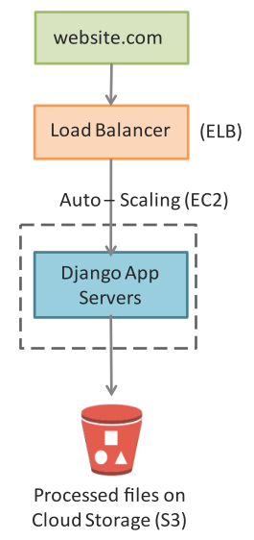
Compute service in Image Processing App

Slide 11
Compute service in Image Processing App

Slide 12
Core Cloud Service Categories
Cloud Compute Services
Cloud Networking Services
Cloud Storage Services
Cloud Security, Identity, and Compliance Services
Cloud Analytics Services
Cloud Database Services

Slide 13
Cloud Networking Services
Your network is another foundation pillar in your infrastructure. The networking infrastructure of your chosen cloud service provider will directly determine the level of security, availability, speed, and reach of your cloud services.
The leading cloud service providers will offer you access to a global network of regions and locations. Each constantly striving to improve their networking infrastructure to provide better bandwidth and faster download times.

Slide 14
Cloud Networking Services
Cloud networking most commonly encompasses the following services:
Content Delivery Network (CDN)
a way to deliver content through multiple geographic locations to deliver high speed and low latency
Dedicated Interconnection
direct access to the cloud providers high-speed network
Domain Name System (DNS)
a scalable way to route users to internet applications via DNS
Load Balancing
a tool to distribute incoming traffic across multiple resources
Virtual Private Network (VPN)
a secure and isolated cloud resource

Slide 15
Cloud Networking Service Providers
Google Cloud
Virtual Private Cloud (VPC)
Cloud DNS
Cloud CDN
Cloud Load Balancing
Amazon Web Services
Amazon VPC
Amazon Route 53
AWS Direct Connect
Elastic Load Balancing
Microsoft Azure
Azure Virtual Network
Azure DNS
Azure Content Delivery Network
Azure Load Balancer

Slide 16
Networking service in Image Processing App

Slide 17
Networking service in Image Processing App

Slide 18
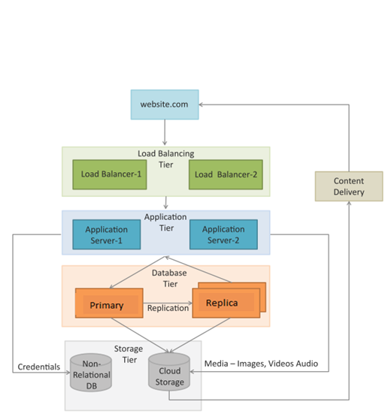
Networking service in Content delivery app
A content delivery network (CDN) which consists of a global network of edge locations is used for media delivery.
CDN is used to speed up the delivery of static content such as images and videos.

Slide 19
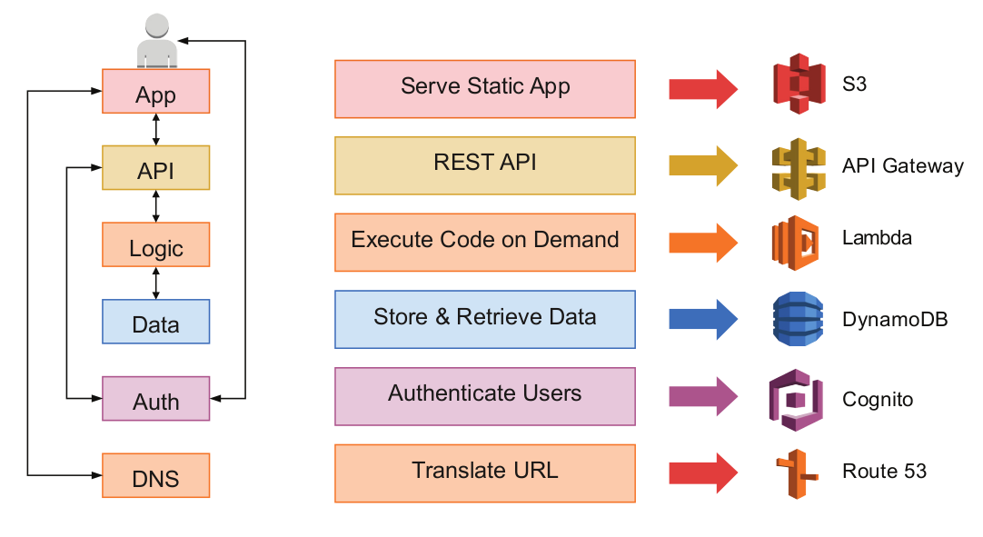
Networking Services - Serverless Applications
Example of a multi-tier web application implemented with the serverless computing model.

Slide 20
Core Cloud Service Categories
Cloud Compute Services
Cloud Networking Services
Cloud Storage Services
Cloud Security, Identity, and Compliance Services
Cloud Analytics Services
Cloud Database Services

Slide 21
Cloud Storage Services
Storage in the cloud involves utilizing a cloud service provider’s infrastructure to securely store your data, apps, and workloads.
Much like the customization of VMs, cloud service providers offer you multiple storage configuration options that can be scaled to match the demands of your business – disk size, amount of storage, and location. They will also support the different storage types including block, file, and object storage.
Certain cloud service providers also offer a range of data transfer services to help you quickly and securely migrate vast volumes of data into their infrastructure.

Slide 22
Cloud Storage Service Providers
Google Cloud
Cloud Storage
Persistent Disk
Cloud Filestore
Data Transfer Services
Amazon Web Services
Amazon EBS
Amazon EFS
Amazon S3
Data Transfer Services
Microsoft Azure
Disk Storage
File Storage
Blob Storage

Slide 23
Storage service in Image Processing App

Slide 24
Storage service in Image Processing App

Slide 25
Storage Services - Serverless Applications
Example of a multi-tier web application implemented with the serverless computing model.

Slide 26
Core Cloud Service Categories
Cloud Compute Services
Cloud Networking Services
Cloud Storage Services
Cloud Security, Identity, and Compliance Services
Cloud Analytics Services
Cloud Database Services

Slide 27
Cloud Security, Identity, and Compliance Services
Security, identity, and compliance in the cloud comprise of a range of tools and services designed to control access to your cloud infrastructure, protect against attacks, and maintain privacy of your data.

Slide 28
Cloud Security, Identity, and Compliance Services
Auditing
a tool track all user activity and create an audit log of who did what, where, and when within your cloud platform.
Compliance
a series of tools and controls to help you track and maintain regulatory compliance.
DDoS Protection
a tool designed to identify and mitigate DDoS attacks in order to prevent application downtime and minimize the latency of your infrastructure.
Encryption
the provision of encryption at rest and in transit to prevent your data from being accessed even in the event of theft.
Firewalls
a collection of firewall tools to filter malicious web traffic and centrally manage firewall rules.
Identity and Access Management
a platform to manage user identities and control who has access to what, and what they can do with that access
Threat Detection
a tool to identify potential threats in cloud environments.

Slide 29
Cloud Security, Identity, and Compliance Service Providers
Google Cloud
Cloud IAM
Cloud Audit Logs
Cloud Security Command Center
Amazon Web Services
Amazon Cognito
AWS Shield
AWS Security Hub
AWS Firewall Manager
Microsoft Azure
Azure Active Directory
Key Vault
Azure Security Center

Slide 30
Core Cloud Service Categories
Cloud Compute Services
Cloud Networking Services
Cloud Storage Services
Cloud Security, Identity, and Compliance Services
Cloud Analytics Services
Cloud Database Services

Slide 31
Cloud Analytics Services
Analytics in the cloud comprises a range of tools and frameworks to help you analyze and extract valuable insight from your data
The availability and sophistication of cloud analytics services continues to expand as Big Data becomes increasingly critical to businesses
The main cloud service providers offer a range of cloud analytics services to help you store, process, analyze, and visualize data.

Slide 32
Cloud Analytics Service Providers
Google Cloud
BigQuery
Cloud Dataflow
Google Looker Studio
Amazon Web Services
Amazon Athena
Amazon EMR
Amazon Redshift
Microsoft Azure
Data Lakes Analytics
HD Insight
Azure Synapse Analytics

Slide 33
Core Cloud Service Categories
Cloud Compute Services
Cloud Networking Services
Cloud Storage Services
Cloud Security, Identity, and Compliance Services
Cloud Analytics Services
Cloud Database Services

Slide 34
Cloud Database Services
Database services in the cloud offer the provision of purpose-built databases you can scale to meet demand with compute and storage resources you can adjust. Cloud databases are fully managed, leaving you free to input, analyze, and utilize your data without the need to consider the underlying infrastructure.
Cloud service providers have expanded to offer a range of relational and non-relational (NoSQL) databases to house your different data needs.
Whether you need an everyday SQL Server database for traditional applications (CRM, ERP, etc.), or wide column database to support a high scale industrial app, you can find it in the cloud.

Slide 35
Cloud Database Service Providers
Google Cloud
Cloud SQL
Cloud Bigtable
Cloud Spanner
Amazon Web Services
Amazon RDS
Amazon DocumentDB
Amazon Managed Apache Cassandra Service
Microsoft Azure
Azure SQL Database
Azure Cosmos DB
Azure Database for MySQL

Slide 36
Categories of cloud services
Core cloud services
Cloud Compute Services
Cloud Networking Services
Cloud Storage Services
Cloud Security, Identity, and Compliance Services
Cloud Analytics Services
Cloud Database Services
Emerging cloud services

Slide 37
Emerging Cloud Service Categories
Alongside the services needed to build your core infrastructure for everyday business, there exists an increasingly popular series of emerging cloud service categories.
These emerging cloud services have evolved to meet technological innovations and tend to be cloud-native rather than traditional on-premises solutions.

Slide 38
Emerging Cloud Service Categories
AI and Machine Learning Cloud Services
Blockchain
Internet of Things (IoT)
…

Slide 39
AI and Machine Learning Cloud Services
AI and machine learning cloud services allow you access to affordable off-the-shelf solutions you can quickly configure, without the large-scale investment in infrastructure that would otherwise be required.

Slide 40
AI and Machine Learning Cloud Services
Chatbots
combining machine learning and AI to deliver innovative chatbots that can be used in a live chat to handle a range of customer service and sales scenarios.
Recognition
combining machine learning and AI for recognition of images and speech.
Speech to Text
using machine learning and speech recognition to convert audio files into text to deliver rapid transcription and convert unstructured data into an analyzable format.
Search
using machine learning tools to index and provide comprehensive and content-rich search results from documents, images, videos, and the web.
Translation
using machine learning tools to recognize and then translate speech or text files.

Slide 41
AI and Machine Learning Cloud Services
Google Cloud
AI Platform
Vision AI
Speech-to-Text
Amazon Web Services
Amazon Comprehend
Amazon Polly
Amazon Translate
Microsoft Azure
Azure Bot Service
Bing Custom Search
Machine Learning Studio

Slide 42
Blockchain
A range of services to organizations to build and manage their own blockchains
These typically span cryptography, large scale ledger databases, or a fully managed blockchain service

Slide 43
Blockchain
Amazon Web Services
Amazon Managed Blockchain and Amazon Quantum Ledger Database (QLDB)
Microsoft Azure
Azure Blockchain Service
Azure Blockchain Workbench
Azure Blockchain Tokens

Slide 44
Internet of Things (IoT)
If Cloud providers offer a growing range of IoT services to support
solutions to connect and secure IoT devices
collecting, storing, and analyzing the data they produce

Slide 45
Internet of Things (IoT)
Google Cloud
Cloud IoT Core
Edge TPU
Amazon Web Services
AWS IoT Core
AWS IoT Button
AWS IoT Analytics
Microsoft Azure
Azure IoT Hub
Azure IoT Central
Azure IoT Edge

Slide 46
Categories of cloud services
Core cloud services
Cloud Compute Services
Cloud Networking Services
Cloud Storage Services
Cloud Security, Identity, and Compliance Services
Cloud Analytics Services
Cloud Database Services
Emerging cloud services
AI and Machine Learning Cloud Services
Blockchain
Internet of Things (IoT)
…

